Slide 1
LESSON 9.3
Bond Enthalpies

Slide 2
LESSON GOALS
I can calculate enthalpy changes from known bond enthalpies and compare these values to experimentally measured values

Slide 3
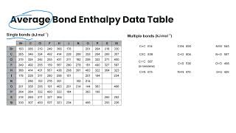
TASK 1: LEARN (MUST DO)
Watch the bond enthalpies video
Complete the appropriate section of the guided note

Slide 4
TASK 3: PRACTICE
Complete the bond enthalpies practice (answers included)
Note: There are must do, should do, and aspire to do questions included in this practice!

Slide 5
TASK 4: MASTERY CHECK (MUST DO)
Complete the bond enthalpies mastery check (see me when you are ready!)

